Slide 1
Wild Animal Intrusion Detection
and Repellent System
Presented by:
Abin JS
Harsha Anand PP
Joel Sebastian
K P Ashil
Lekha Treesa Titus
Parvathy Gopan
Ramkrishna K
Guided by:
Prof Dr. Panchami V
Prof Dr Lavanya Settipalli

Slide 2
Contents
Introduction
Literature Survey
Research gap
Problem statement
Research Objectives
Existing system
Proposed System
Implementation and Results
Performance Evaluation
Conclusion and Future Scope
References

Slide 3
Introduction
Introduction
Literature Survey
Research Gap
Problem Statement
Research Objectives
Existing System
Proposed System
Implementation
and Results
Performance
Evaluation
Conclusion and
Future Scope
References
Impact of animal intrusions
Limitations of traditional practices
Deep Learning based Detection Module
Non-invasive Repellent System

Slide 4
Literature Survey
Introduction
Literature Survey
Research Gap
Problem Statement
Research Objectives
Existing System
Proposed System
Implementation
and Results
Performance
Evaluation
Conclusion and
Future Scope
References
Y. Rakesh Kumar, Donthula Bhavana Yadav, K. Jagruthi, K. Laxmi, Priyanka, “Night Vision Thermal sensor based Animal Movement Observation using CNN and YOLO v3”, International Journal of Advances in Computer Science and Technology, Volume 12 No. 6, June 2023, https://doi.org/10.30534/ijacst/2023/011262023.
Key-Takeaways
Utilized CNN for thermal image classification
YOLOv3 for animal movement detection in thermal videos
Advantages
Works well in low-light conditions
Disadvantages
Required large training data

Slide 5
Literature Survey
Introduction
Literature Survey
Research Gap
Problem Statement
Research Objectives
Existing System
Proposed System
Implementation
and Results
Performance
Evaluation
Conclusion and
Future Scope
References
B. Natarajan, R. Elakkiya, R. Bhuvaneswari, K. Saleem, D. Chaudhary And S. H. Samsudeen, “Creating Alert Messages Based On Wild Animal Activity Detection Using Hybrid Deep Neural Networks,” in IEEE Access, Vol. 11, Pp. 67308-67321, 2023, Doi: 10.1109/Access.2023.3289586.
Key-Takeaways
VGG-19 + Bi-LSTM algorithm.
Animal detection and alert generation
Advantages
Improved accuracy
Disadvantages
Misclassification

Slide 6
Literature Survey
Introduction
Literature Survey
Research Gap
Problem Statement
Research Objectives
Existing System
Proposed System
Implementation
and Results
Performance
Evaluation
Conclusion and
Future Scope
References
Beibei Xu, Wensheng Wang, Greg Falzon, Paul Kwan, Leifeng Guo, Guipeng Chen, Amy Tait, Derek Schneider, “Automated cattle counting using Mask R-CNN in quadcopter vision system”, Computers and Electronics in Agriculture, Volume 171, 2020, 105300, ISSN 0168-1699, https://doi.org/10.1016/j.compag.2020.105300.
Key-Takeaways
Mask R-CNN for detecting and counting cattle using aerial images
Advantages
High accuracy
Robust to illumination changes
Disadvantages
Required high computational resources

Slide 7
Literature Survey
Introduction
Literature Survey
Research Gap
Problem Statement
Research Objectives
Existing System
Proposed System
Implementation
and Results
Performance
Evaluation
Conclusion and
Future Scope
References
K. V. Reddy Et Al., “Edge AI In Sustainable Farming: Deep Learning-Driven IoT Framework To Safeguard Crops From Wildlife Threats,” In IEEE Access, Vol. 12, Pp. 77707-77723, 2023, Doi: 10.1109/Access.2024.3406585.
Key-Takeaways
Edge AI and TinyML for animal intrusion and detection.
Light-weight deep learning model EvoNet for animal classification
Advantages
Lightweight model
Disadvantages
Pruning and quantization - decrease in model’s accuracy

Slide 8
Literature Survey
Introduction
Literature Survey
Research Gap
Problem Statement
Research Objectives
Existing System
Proposed System
Implementation
and Results
Performance
Evaluation
Conclusion and
Future Scope
References
K Balakrishna, Fazil Mohammed, C.R. Ullas, C.M. Hema, S.K. Sonakshi, “Application of IOT and machine learning in crop protection against animal intrusion”, Global Transitions Proceedings, Volume 2, Issue 2, 2021, Pages 169-174, ISSN 2666-285X, https://doi.org/10.1016/j.gltp.2021.08.061.
Key-Takeaways
Usage of Raspberry Pi as hardware
Firestore firebase for back-end services
Advantages
Automated monitoring
Cost effective
Disadvantages
Less effective Repellent System
Limited night vision capability

Slide 9
Literature Survey
Introduction
Literature Survey
Research Gap
Problem Statement
Research Objectives
Existing System
Proposed System
Implementation
and Results
Performance
Evaluation
Conclusion and
Future Scope
References
Mr. Akash B. Yele, Er. Rajesh M. Dharaskar, Dr. K.G. Dhande , “Solar Powered Animal Intrusion Detection and Repellent Device”, International Journal of Innovative Science, Engineering & Technology, Vol. 09 Issue 03, March 2022 IJISET_V9_I03_09.pdf.
Key-Takeaways
Chose Raspberry Pi + Mask R-CNN for broader detection
Integrated Azure IoT Cloud for efficiency
Advantages
Solar powered and eco-friendly
Non-toxic, safe for animals and environment
Disadvantages
Limited detection range (3 meters)
Basic PIR sensors results in false positives

Slide 10
Literature Survey
Introduction
Literature Survey
Research Gap
Problem Statement
Research Objectives
Existing System
Proposed System
Implementation
and Results
Performance
Evaluation
Conclusion and
Future Scope
References
D. Ranparia, G. Singh, A. Rattan, H. Singh and N. Auluck, "Machine learning-based Acoustic Repellent System for Protecting Crops against Wild Animal Attacks," 2020, pp. 534-539, doi: 10.1109/ICIIS51140.2020.9342713.
Key-Takeaways
Frequency generator
Mask RCNN for classification
Advantages
Improved efficiency
Mask RCNN for classification
Disadvantages
Resource Demands
Need for Training

Slide 11
Literature Survey
Introduction
Literature Survey
Research Gap
Problem Statement
Research Objectives
Existing System
Proposed System
Implementation
and Results
Performance
Evaluation
Conclusion and
Future Scope
References
Patil, Hardiki and Ansari, Namrata, Automated Wild-Animal Intrusion Detection and Repellent System Using Artificial Intelligence of Things (MAY 7, 2021).
Key-Takeaways
Automated detection system
Acoustic repellent system
Advantages
Non-lethal methods like alarms and lights
Cost effectiveness
Limitations
Reduced accuracy in low-light conditions
Susceptible to weather damage

Slide 12
Literature Survey
Introduction
Literature Survey
Research Gap
Problem Statement
Research Objectives
Existing System
Proposed System
Implementation
and Results
Performance
Evaluation
Conclusion and
Future Scope
References
Sabina, Nadia & P.V, Haseena. (2022). An Intelligent Animal Repellent System for Crop Protection: A Deep Learning Approach. International Journal of Engineering Research in Computer Science and Engineering. DOI:10.36647/IJERCSE/09.09.Art014
Key-Takeaways
Integrated GSM-based notifications via React Native app
Adopted ultrasonic repellent system
Advantages
Real-time monitoring and alerts
Humane, non-lethal repellent methods
Limitations
Repelling limited to ultrasonic-sensitive animals
Dependent on camera quality and lighting conditions

Slide 13
Literature Survey
Introduction
Literature Survey
Research Gap
Problem Statement
Research Objectives
Existing System
Proposed System
Implementation
and Results
Performance
Evaluation
Conclusion and
Future Scope
References
Bavane, Vikas & Raut, Arti & Sonune, Swapnil & Bawane, A & Jawandhiya, Pradip. (2018). “Protection of Crops from Wild Animals Using Intelligent Surveillance System”.
Key-Takeaways
Incorporated real-time notifications
System that sounds through solar animal repellent
Advantages
Reliable GSM alerts in low-internet areas
Enables remote monitoring for farmers
Limitations
Susceptible to weather damage
Dependent on GSM coverage

Slide 14
Research Gap
Introduction
Literature Survey
Research Gap
Problem Statement
Research Objectives
Existing System
Proposed System
Implementation
and Results
Performance
Evaluation
Conclusion and
Future Scope
References
Choice of sensor for monitoring
Well Trained Detection module in all conditions
Lack of optimized, species-specific acoustic deterrents

Slide 15
Problem Statement
Introduction
Literature Survey
Research Gap
Problem Statement
Research Objectives
Existing System
Proposed System
Implementation
and Results
Performance
Evaluation
Conclusion and
Future Scope
References
To develop an IoT based Animal Intrusion Repellent System with accurate detection of intruding wild animals and non-invasive repellent methods

Slide 16
Research Objectives
Introduction
Literature Survey
Research Gap
Problem Statement
Research Objectives
Existing System
Proposed System
Implementation
and Results
Performance
Evaluation
Conclusion and
Future Scope
References
Overcome challenges of animal detection at low light conditions
Explore the possibility of deep learning networks in wildlife conservation
Develop a species specific acoustic Repellent System

Slide 17
Existing System
Introduction
Literature Survey
Research Gap
Problem Statement
Research Objectives
Existing System
Proposed System
Implementation
and Results
Performance
Evaluation
Conclusion and
Future Scope
References
Includes electric fencing, traditional trapping methods, and repellents
Ineffective against frequent intrusions
Often harm for both animals and human life

Slide 18
Proposed System
Introduction
Literature Survey
Research Gap
Problem Statement
Research Objectives
Existing System
Proposed System
Implementation
and Results
Performance
Evaluation
Conclusion and
Future Scope
References
ML Module
IoT Module
Repellent Module

Slide 19
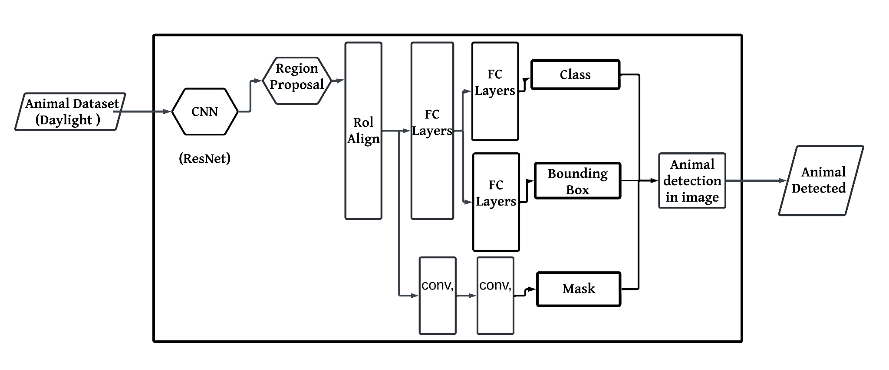
ML Module
Introduction
Literature Survey
Research Gap
Problem Statement
Research Objectives
Existing System
Proposed System
Implementation
and Results
Performance
Evaluation
Conclusion and
Future Scope
References
Figure 1: ML Module

Slide 20
ML Module
Introduction
Literature Survey
Research Gap
Problem Statement
Research Objectives
Existing System
Proposed System
Implementation
and Results
Performance
Evaluation
Conclusion and
Future Scope
References
Animal capture and detection
Thermal Infrared surveillance used
Mask R-CNN

Slide 21
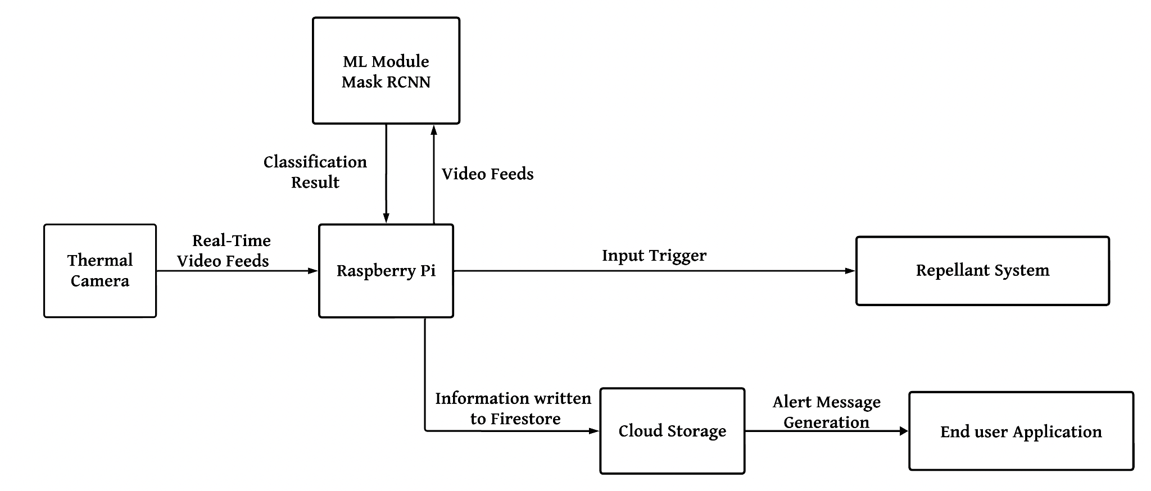
IoT Module
Introduction
Literature Survey
Research Gap
Problem Statement
Research Objectives
Existing System
Proposed System
Implementation
and Results
Performance
Evaluation
Conclusion and
Future Scope
References
Figure 2: IoT Module

Slide 22
IoT Module
Introduction
Literature Survey
Research Gap
Problem Statement
Research Objectives
Existing System
Proposed System
Implementation
and Results
Performance
Evaluation
Conclusion and
Future Scope
References
Raspberry Pi as the central processing unit
Thermal Camera for capturing thermal signatures
Processes data using ML model and triggers repellent system
Cloud storage for sending detection alerts

Slide 23
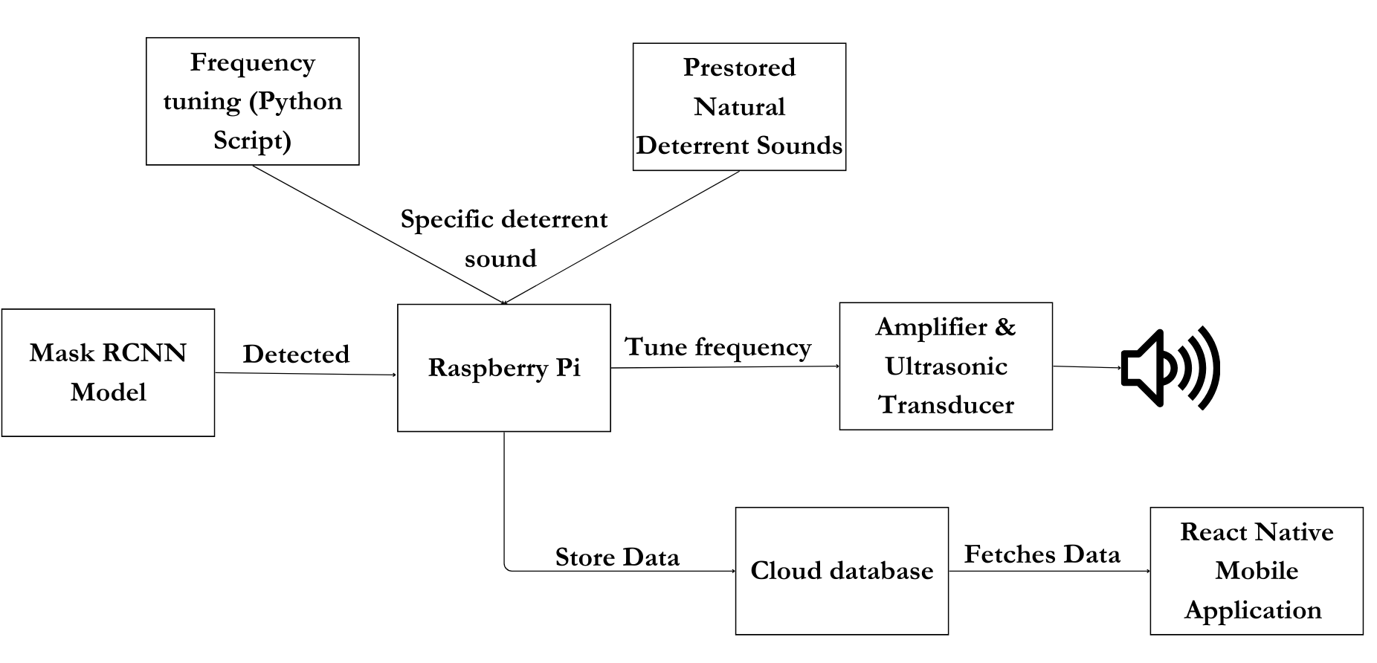
Repellent and Alert System
Introduction
Literature Survey
Research Gap
Problem Statement
Research Objectives
Existing System
Proposed System
Implementation
and Results
Performance
Evaluation
Conclusion and
Future Scope
References
Figure 3: Repellent and Alert System

Slide 24
Repellent and Alert System
Introduction
Literature Survey
Research Gap
Problem Statement
Research Objectives
Existing System
Proposed System
Implementation
and Results
Performance
Evaluation
Conclusion and
Future Scope
References
Generate species-specific sound frequencies to deter wildlife
Bee sounds for elephants (infrasonic range)
Vervet monkey calls for tigers (ultrasonic range)
Ultrasonic transducer emits sound via amplifier
Real-time alerts with history tracking
Mobile app built in React Native
Firebase for authentication and log storage
Integrated for real-time responses

Slide 25
ML Module
Introduction
Literature Survey
Research Gap
Problem Statement
Research Objectives
Existing System
Proposed System
Implementation
and Results
Performance
Evaluation
Conclusion and
Future Scope
References
Trained on 4 classes - elephant, giraffe, leopard and tiger
Dataset of 2,500 images (4:1 ratio for training and validation)
Resnet 101 backbone
Pretrained Imagenet weights
Output is send to IoT module

Slide 26
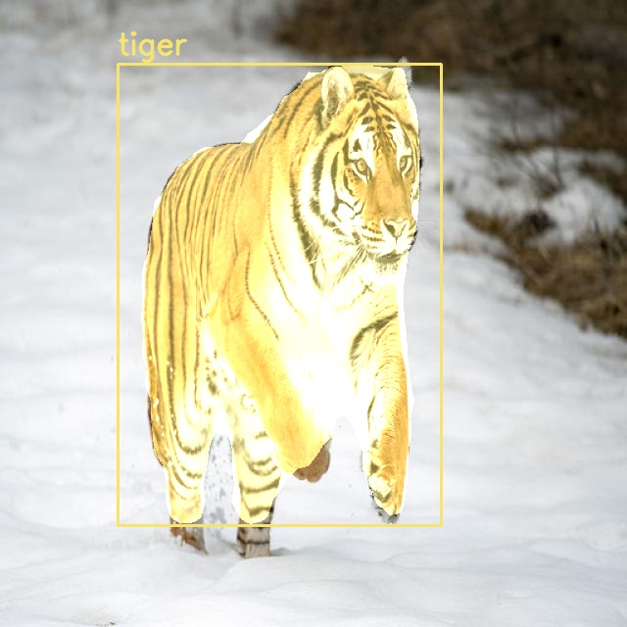
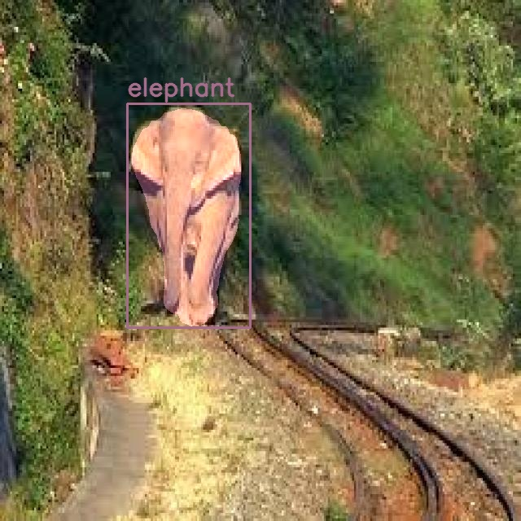
ML Module
Introduction
Literature Survey
Research Gap
Problem Statement
Research Objectives
Existing System
Proposed System
Implementation
and Results
Performance
Evaluation
Conclusion and
Future Scope
References
Figure 4: Animal Detection and Segmentation for Daylight Images

Slide 27
IoT Module
Introduction
Literature Survey
Research Gap
Problem Statement
Research Objectives
Existing System
Proposed System
Implementation
and Results
Performance
Evaluation
Conclusion and
Future Scope
References
Integrated Camera module with Raspberry Pi
Firebase connectivity for real-time alerts
ML module integration for successful detection
Animal class and timestamp sent to Firebase Firestore
Successful generation of species-specific repellent frequencies

Slide 28
Repellent and Alert System
Introduction
Literature Survey
Research Gap
Problem Statement
Research Objectives
Existing System
Proposed System
Implementation
and Results
Performance
Evaluation
Conclusion and
Future Scope
References
Collected and fine-tuned frequencies using MATLAB
Infrasonic bee alarm calls for elephants
Ultrasonic vervet monkey alarm calls for tigers
Sound frequencies stored as .wav files on Raspberry Pi
Python script to select random frequencies to avoid adaptability
TSH82 OpAmp board for amplification
Piezoelectric ultrasonic speaker (2.5-60 KHz) as transducer

Slide 29
Repellent and Alert System
Introduction
Literature Survey
Research Gap
Problem Statement
Research Objectives
Existing System
Proposed System
Implementation
and Results
Performance
Evaluation
Conclusion and
Future Scope
References
Developed React Native mobile app for cross-platform use
Intuitive UI shows real-time alerts and intrusion history
Displays last five recorded wildlife intrusions
Integrated Firebase for secure authentication and data storage
Fetches intrusion logs from Firestore
Provides instant access to alert logs and system updates

Slide 30


Mobile Application
Introduction
Literature Survey
Research Gap
Problem Statement
Research Objectives
Existing System
Proposed System
Implementation
and Results
Performance
Evaluation
Conclusion and
Future Scope
References
Figure 6:
Mobile Application Login Page

Slide 31
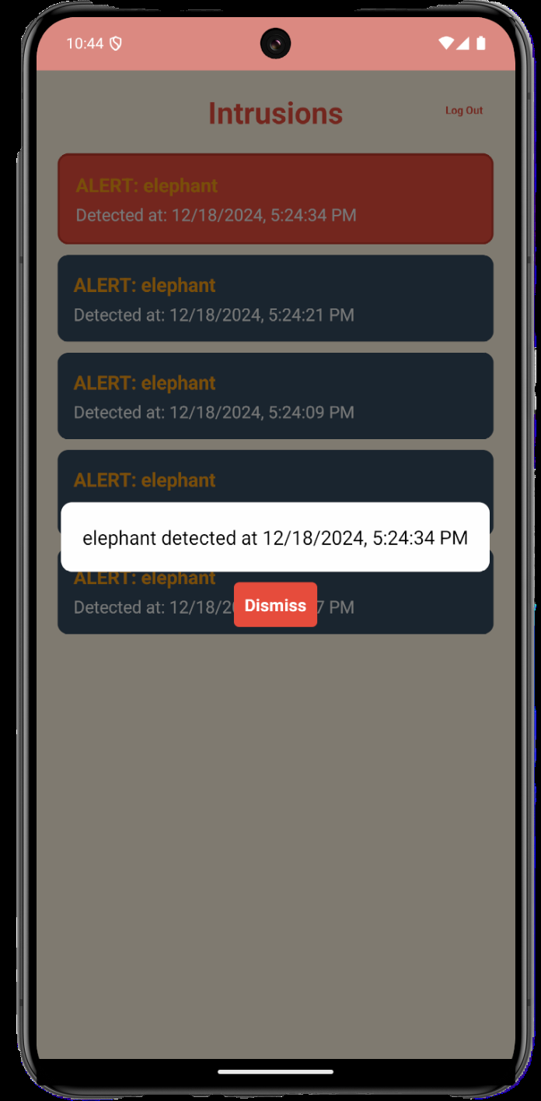
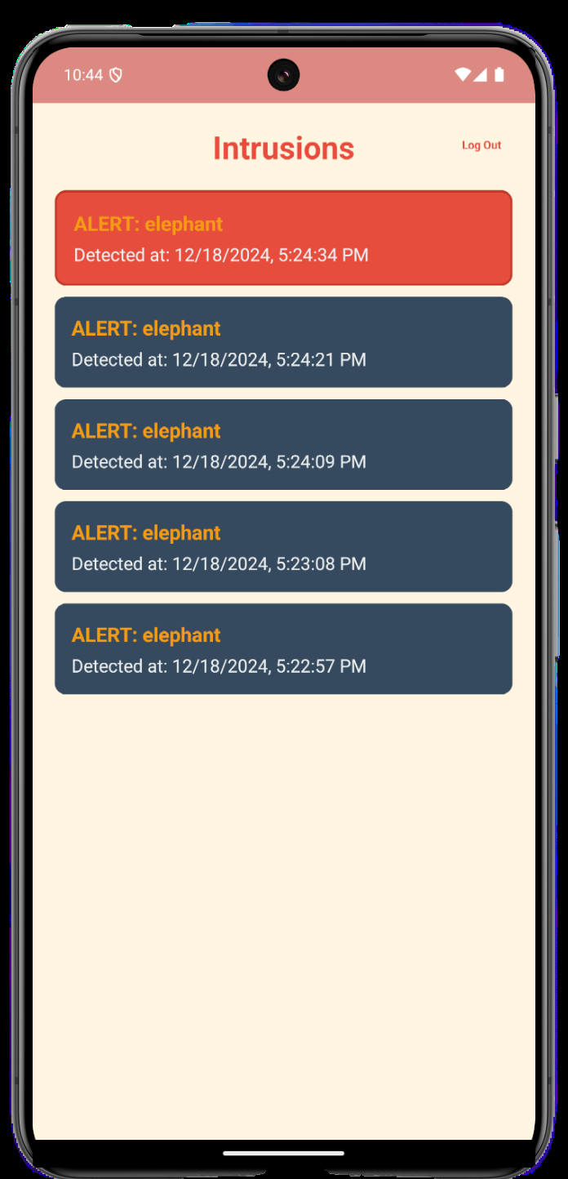
Mobile Application
Introduction
Literature Survey
Research Gap
Problem Statement
Research Objectives
Existing System
Proposed System
Implementation
and Results
Performance
Evaluation
Conclusion and
Future Scope
References
Figure 7:
Mobile Application Alert
and Notifications

Slide 32
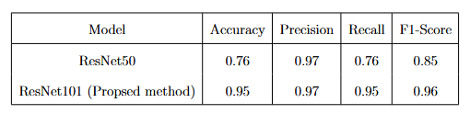
ML Module Metrics Comparison
Introduction
Literature Survey
Research Gap
Problem Statement
Research Objectives
Existing System
Proposed System
Implementation
and Results
Performance
Evaluation
Conclusion and
Future Scope
References
Performance analysis comparison

Slide 33
Overall System Efficiency
Introduction
Literature Survey
Research Gap
Problem Statement
Research Objectives
Existing System
Proposed System
Implementation
and Results
Performance
Evaluation
Conclusion and
Future Scope
References
Automation reduces manual intervention for threat response
Provides real-time alerts and actionable information for users
Repels animals harmlessly using sound frequencies

Slide 34
Conclusion and Future Scope
Introduction
Literature Survey
Research Gap
Problem Statement
Research Objectives
Existing System
Proposed System
Implementation
and Results
Performance
Evaluation
Conclusion and
Future Scope
References
Conclusion
Developed an IoT based lightweight security system where intruding animals detected using Mask R-CNN and repelled using sound -based repellent device, causing no harm to animals
Future Scope
Make the model universal
Usage of renewable sources of energy
Usage of more efficient hardware

Slide 35
References
Introduction
Literature Survey
Research Gap
Problem Statement
Research Objectives
Existing System
Proposed System
Implementation
and Results
Performance
Evaluation
Conclusion and
Future Scope
References
[1] Y. Rakesh Kumar, Donthula Bhavana Yadav, K. Jagruthi, K. Laxmi, Priyanka, “Night Vision Thermal sensor based Animal Movement Observation using CNN and YOLO v3”, International Journal of Advances in Computer Science and Technology, Volume 12 No. 6, June 2023, https://doi.org/10.30534/ijacst/2023/011262023.
[2] B. Natarajan, R. Elakkiya, R. Bhuvaneswari, K. Saleem, D. Chaudhary and S. H. Samsudeen, "Creating Alert Messages Based on Wild Animal Activity Detection Using Hybrid Deep Neural Networks," in IEEE Access, vol. 11, pp. 67308-67321, 2023, doi: 10.1109/ACCESS.2023.3289586.
[3 ]Beibei Xu, Wensheng Wang, Greg Falzon, Paul Kwan, Leifeng Guo, Guipeng Chen, Amy Tait, Derek Schneider, “Automated cattle counting using Mask R-CNN in quadcopter vision system”, Computers and Electronics in Agriculture, Volume 171, 2020, 105300, ISSN 0168-1699, https://doi.org/10.1016/j.compag.2020.105300.
[4] K. V. Reddy Et Al., “Edge AI In Sustainable Farming: Deep Learning-Driven IoT Framework To Safeguard Crops From Wildlife Threats,” In IEEE Access, Vol. 12, Pp. 77707-77723, 2023, Doi: 10.1109/Access.2024.3406585.

Slide 36
References
Introduction
Literature Survey
Research Gap
Problem Statement
Research Objectives
Existing System
Proposed System
Implementation
and Results
Performance
Evaluation
Conclusion and
Future Scope
References
[5] K Balakrishna, Fazil Mohammed, C.R. Ullas, C.M. Hema, S.K. Sonakshi, “Application of IOT and machine learning in crop protection against animal intrusion”, Global Transitions Proceedings, Volume 2, Issue 2, 2021, Pages 169-174, ISSN 2666-285X, https://doi.org/10.1016/j.gltp.2021.08.061.
[6] Mr. Akash B. Yele, Er. Rajesh M. Dharaskar, Dr. K.G. Dhande , “Solar Powered Animal Intrusion Detection and Repellent Device”, International Journal of Innovative Science, Engineering & Technology, Vol. 09 Issue 03, March 2022 IJISET_V9_I03_09.pdf.
[7] D. Ranparia, G. Singh, A. Rattan, H. Singh and N. Auluck, "Machine learning-based Acoustic Repellent System for Protecting Crops against Wild Animal Attacks," 2020, pp. 534-539, doi: 10.1109/ICIIS51140.2020.9342713.
[8] Patil, Hardiki and Ansari, Namrata, Automated Wild-Animal Intrusion Detection and Repellent System Using Artificial Intelligence of Things (MAY 7, 2021).

Slide 37
References
Introduction
Literature Survey
Research Gap
Problem Statement
Research Objectives
Existing System
Proposed System
Implementation
and Results
Performance
Evaluation
Conclusion and
Future Scope
References
[9] Sabina, Nadia & P.V, Haseena. (2022). An Intelligent Animal Repellent System for Crop Protection: A Deep Learning Approach. International Journal of Engineering Research in Computer Science and Engineering. DOI:10.36647/IJERCSE/09.09.Art014
[10] Bavane, Vikas & Raut, Arti & Sonune, Swapnil & Bawane, A & Jawandhiya, Pradip. (2018). “Protection of Crops from Wild Animals Using Intelligent Surveillance System”.

Slide 38
THANK YOU

